Slide 1




Elevate
MALICIOUS CODES:
DEFINITION OF MALICIOUS CODE,
HOW IT WORKS, COMMON
DELIVERY METHODS, AND ITS
EFFECTS ON COMPUTER SYSTEMS
Testing for Security
Securing Systems Through Authorized Testing
Presented by
GROUP 5

Slide 2


DEFINITON AND OVERVIEW
Elevate
WHAT IS MALICIOUS CODE?
Is a any computer program, script, or set of instructions written intenionally to cause harm, steal data or break a computer system network.
OVERVIEW
  Can spread through infected files, links, email, attachments, and unsafe downloads.
  May damage files, steal data, or let attackers control a device.
  Examples include viruses,, worms, Trojan horses, ransomware and spyware.
KEY IDEA
Malicious code threatens the confidentiality integrity, and security of computer system.

Slide 3

HOW THE ATTACKS OCCURS?
  ENTRY
Infected files or suspicious
  ACTIVATION
infected files or suspicious
  HARMFUL ACTIVATION
Steals data or damages files
  IMPACT
Data loss or security risks

Slide 4
TYPES OF
MALICIOUS CODE
01
Virus
02
Worms
Reflicate itself between systems.
Attaches to files
03
Trojan Horse
04
Ransomware
Disguised itself as legitimate software.
Locks or encryt files.
05
Spyware
06
Rootkits
Secretly collects information
Hidden malicious software
Elevate

Slide 5
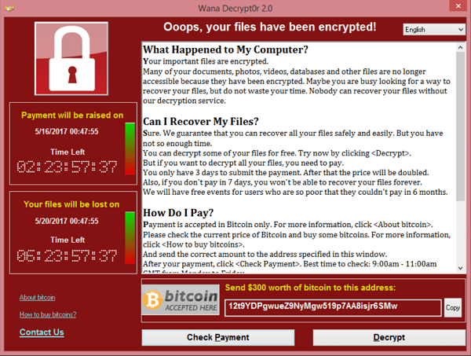
Elevate
REAL WORLD EXAMPLES
  A ransomware attack that ecrypted files and disrupted hospitals and businesses worldwirde
WANNACRY
RANSOMWARE

Slide 6
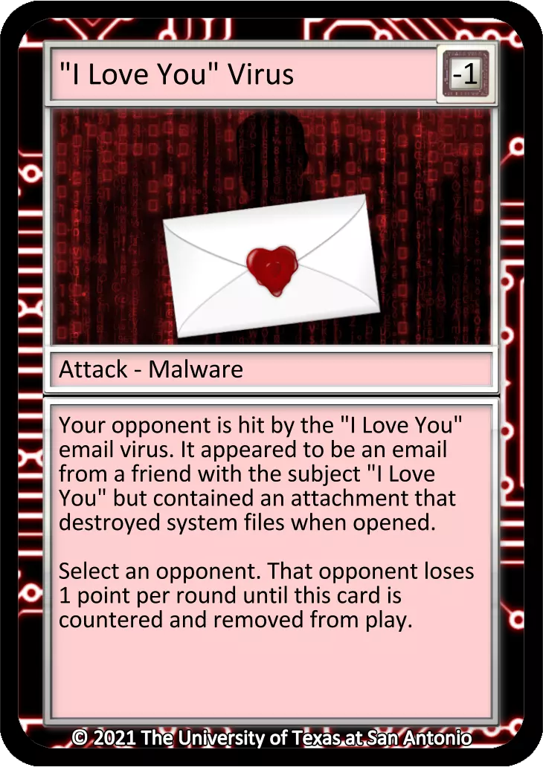
Elevate
NETWORK ATTACKS
Attempting unauthorized access.
I LOVE YOU
VIRUS
Year 2000
  A love letter that spread through email attachments and damaged files on infected computers.

Slide 7
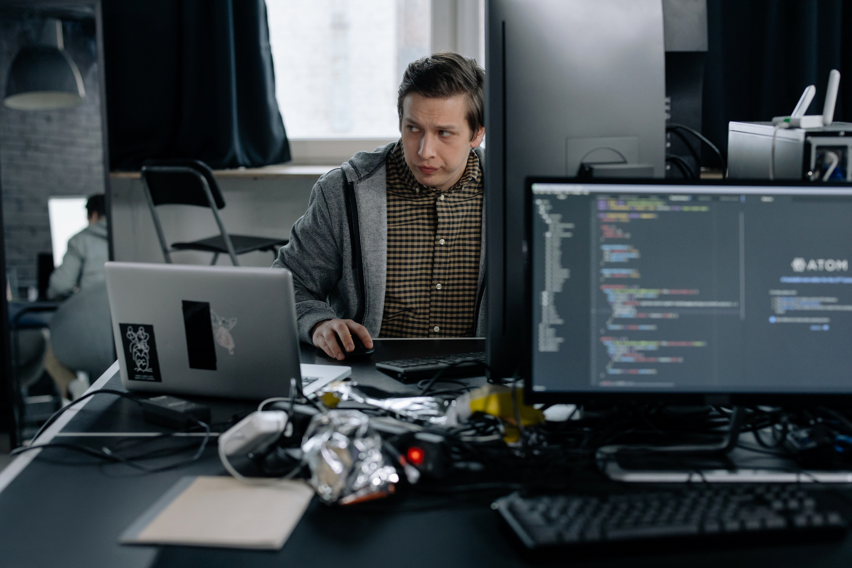
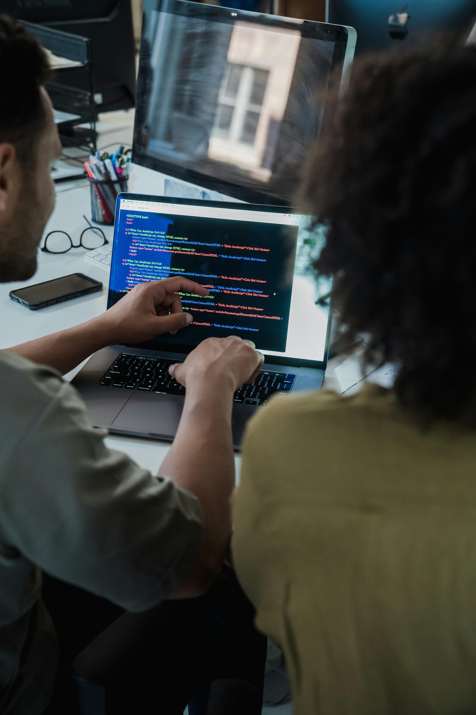
EFFECTS AND RISKS OF MALICIOUS CODE
Cybersecurity Across Industries
  DATA THEFT
  FILE DAMAGE
  SYSTEM DISRUPTION
  FINANCIAL LOSS
Elevate

Slide 8

PREVENTION AND SAFETY MEASURES
Elevate
The Numbers Behind Security
USE ANTIVIRUS SOFTWARE
UPDATE YOUR SYSTEM
AVOID SUSPICIOUS LINKS
BACK UP IMPORTANT FILES
Detect and block malicious programs.
Fix security weaknesses by updating software regularly.
Do not open unknown links or unexpected attachments.
Keep copies of important data in a safe location.

Slide 9
CONCLUSION
Malicious code can harm computers by stealing personal information, damaging files, or disrupting systems. By learning about its different types and how to prevent it, we can protect our devices and stay safe online.
THINK BEFORE YOU CLICK.
Elevate

Slide 10
SUMMARY
  Cybersecurity and Infrastructure Security Agency (CISA) — Official website
  Microsoft Security — Malware and cybersecurity information
  National Cyber Security Centre (NCSC) — Cybersecurity guidance

